Slide 1
Zurich
Single Lock-In
Lee Jong Geon

Slide 2
Lase Week…
MATLAB
Algorithm 최적 하드웨어 추천은 어려움
License가 학교에서 제공된것 ➔ 부가 서비스 권한이 없음
Consulting Program ➔ 비용
Zurich Single Lock In Amp.

Slide 3
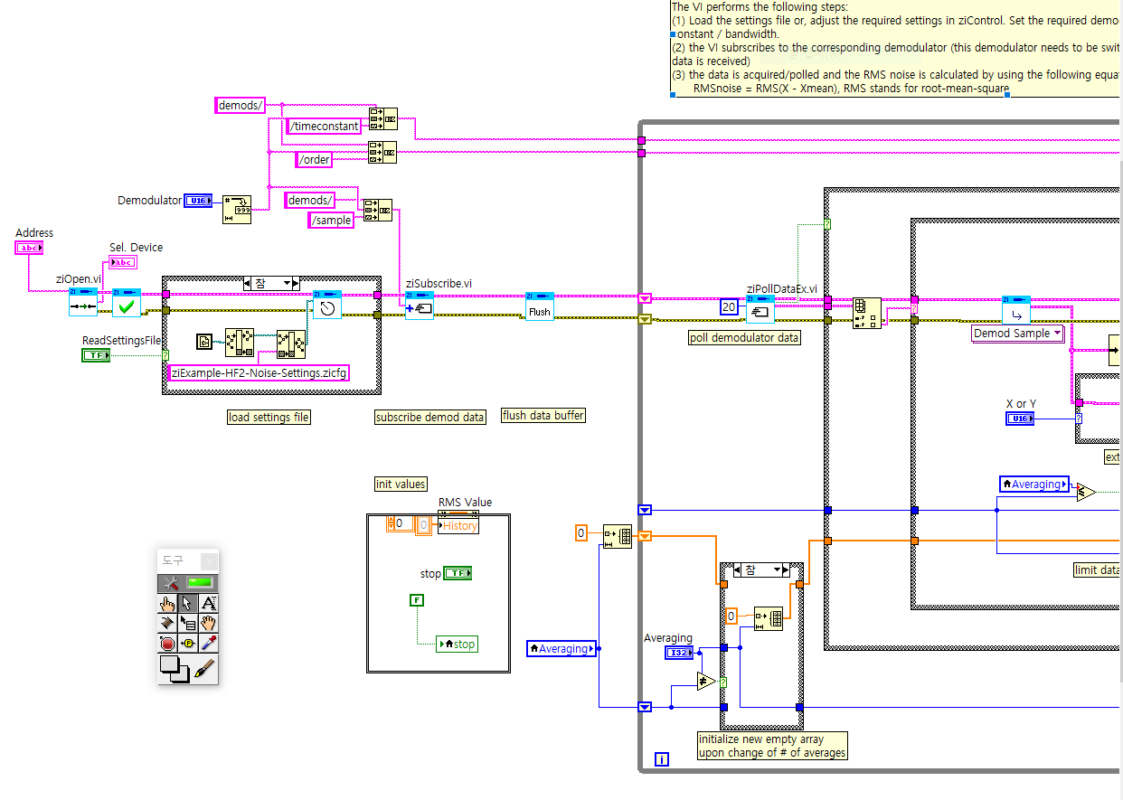
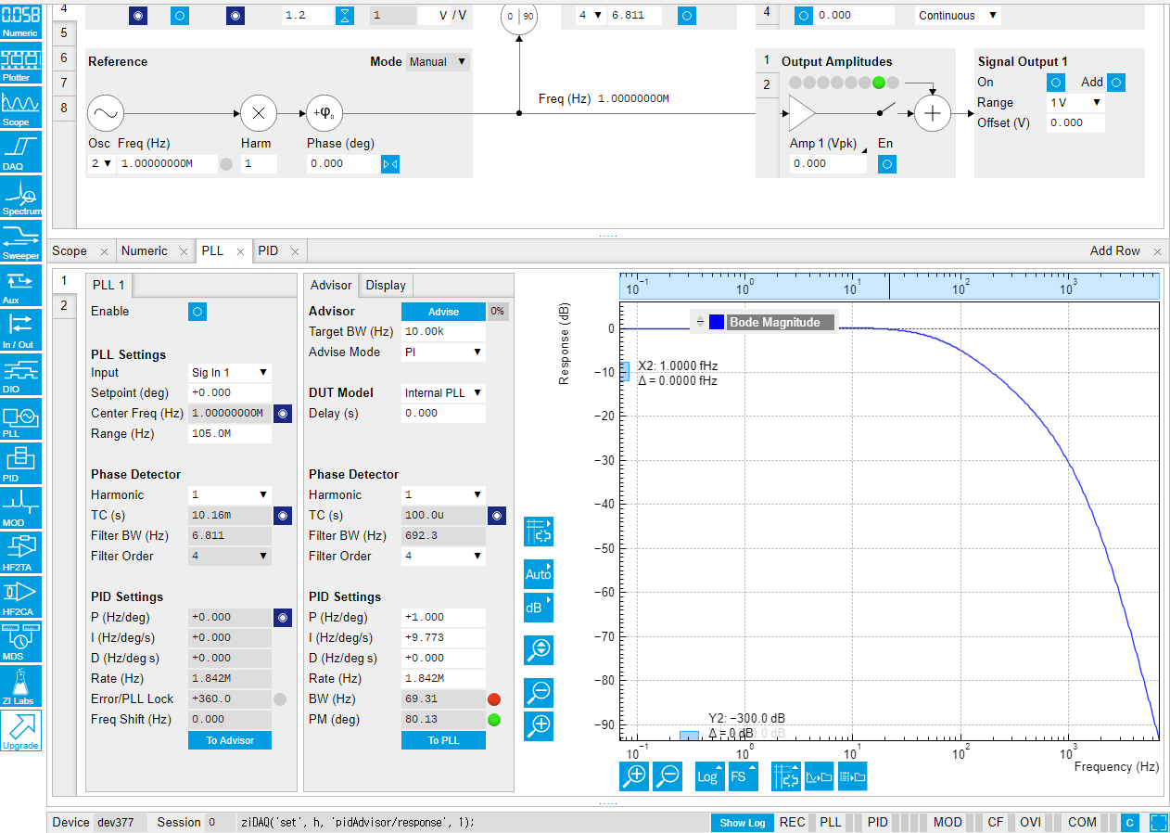
Week Plan
Zurich Lock-In Amplifier
LabVIEW Programming (Scope module, Noise measure example and etc.)
PLL, PID function

